Slide 1
Transitioning to Object Oriented Programing

Slide 2
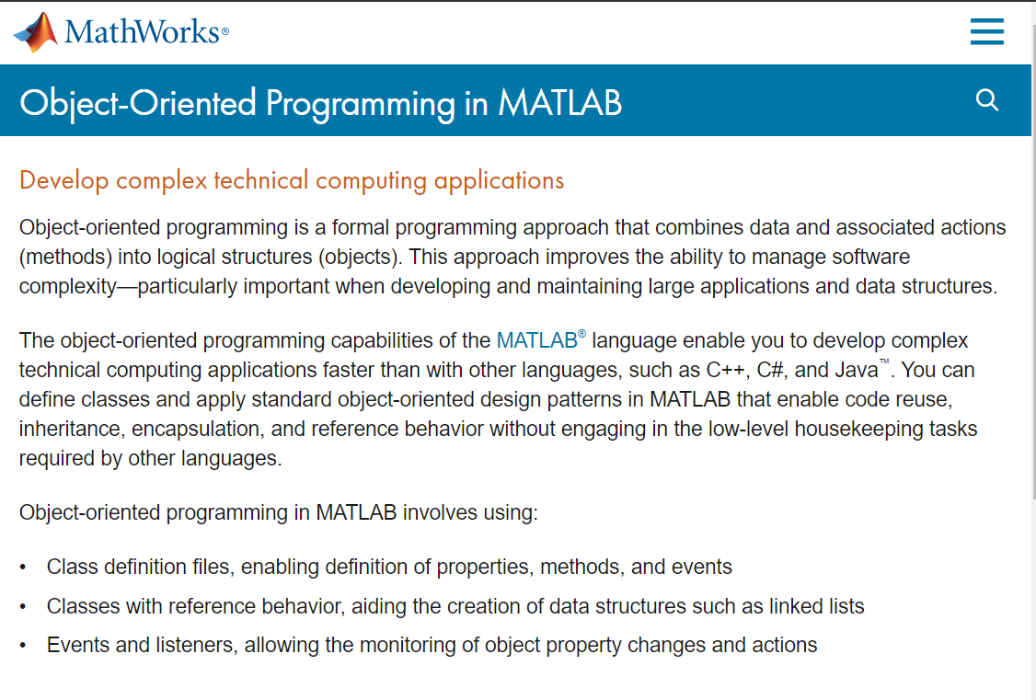
Transitioning to Object Oriented Programing

Slide 3
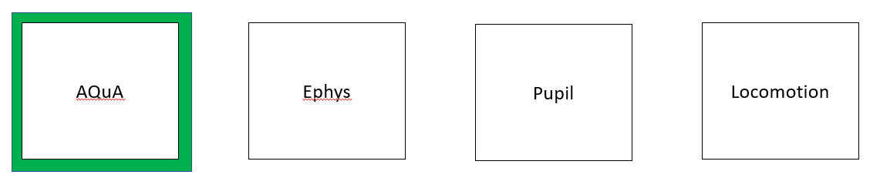
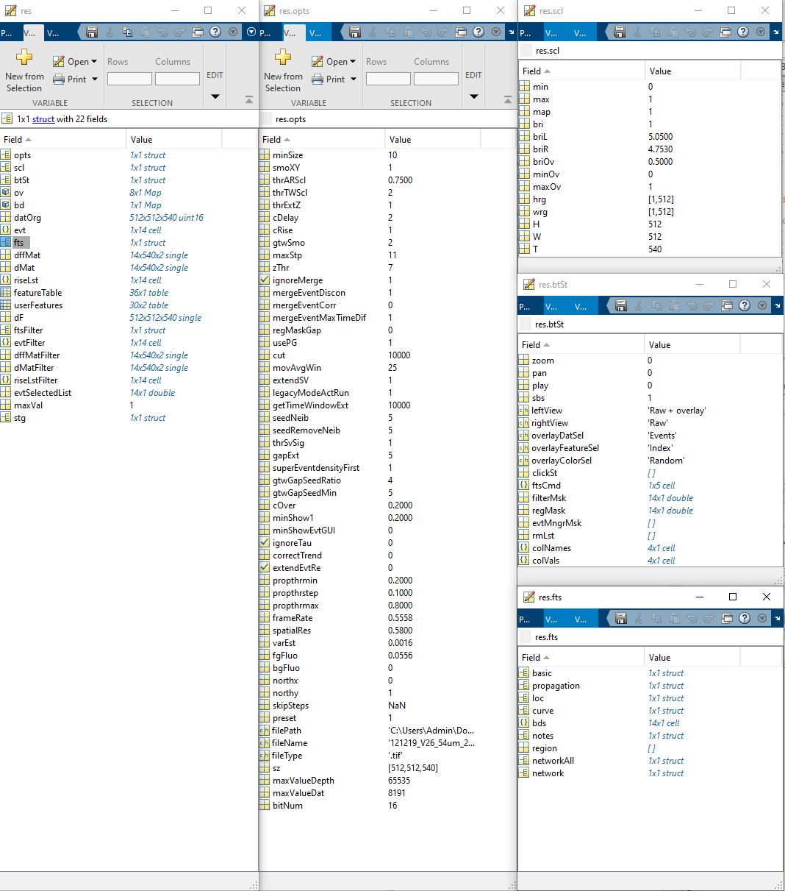
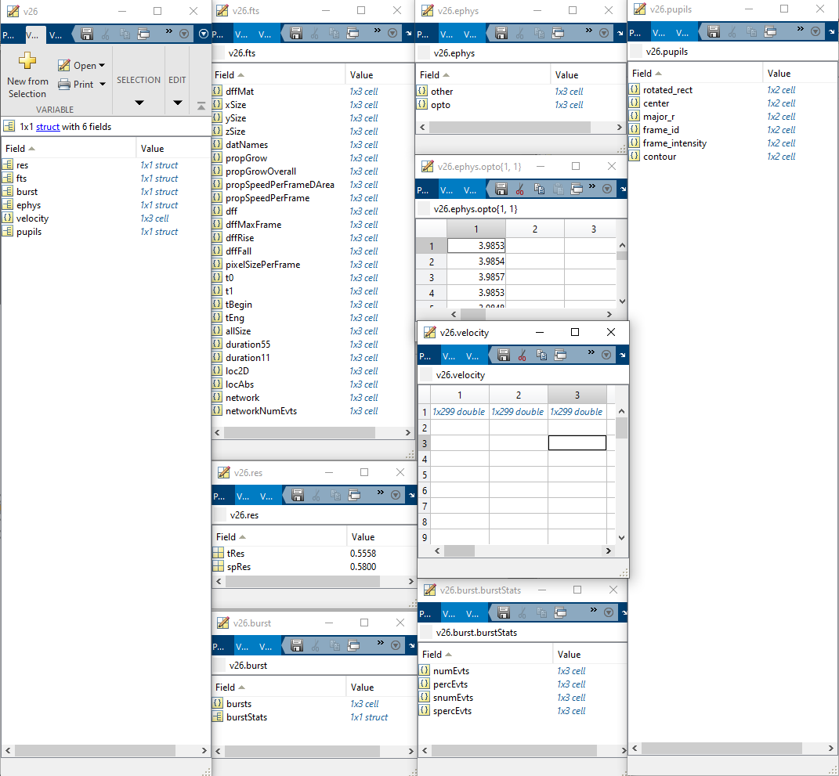
Extracting salient information
T = ~35s
Preprocess
Functions:
readFts
readEphys
readPupil
detectBursts
detectSparkles
opto2velocity
…
One trial:
Data structure is >700 MB
Three trials
Data structure is ~3 MB

Slide 4
Transitioning to Object Oriented Programing
Scripts
Data
Parameters

Slide 5
Transitioning to Object Oriented Programing
Scripts
Data
Parameters
Contain many ‘functions’
Often copy/pasted for each new trial / experiment
Often large and cumbersome
After preprocessing, often stored separately from analysis and plotting functions
Can change between experiments
Need to be linked permanently to the analyzed dataset

Slide 6
Transitioning to Object Oriented Programing
Scripts
Data
Parameters
Master Scripts
Analysis Results
Figures and Plots

Slide 7
Scripts
Data
Parameters
Transitioning to Object Oriented Programing
Functions
(i/o)
Class Object
Analysis Results
Figures and Plots

Slide 8
Extracting salient information
T = ~35s
Preprocess
Functions:
readFts
readEphys
readPupil
detectBursts
detectSparkles
opto2velocity
…
One trial:
Data structure is >700 MB
Three trials
Data structure is ~3 MB

Slide 9
Transitioning to Object Oriented Programing
Abstraction: The process of picking out (abstracting) common features of objects and procedures.
Class: A category of objects. The class defines all the common properties of the different objects that belong to it.
Encapsulation: The process of combining elements to create a new entity. A procedure is a type of encapsulation because it combines a series of computer instructions.
Information hiding: The process of hiding details of an object or function. Information hiding is a powerful programming technique because it reduces complexity.
Inheritance: a feature that represents the "is a" relationship between different classes.
Interface: the languages and codes that the applications use to communicate with each other and with the hardware.
Messaging: Message passing is a form of communication used in parallel programming and object-oriented programming.
Object: a self-contained entity that consists of both data and procedures to manipulate the data.
Polymorphism: A programming language's ability to process objects differently depending on their data type or class.
Procedure: a section of a program that performs a specific task.
Scripts
Data
Parameters
Functions
(i/o)
Class Objects

Slide 10
Transitioning to Object Oriented Programing
One trial
Class Object
Related Trials
Experimental Comparison
Functions
(i/o)
Data
Parameters

Slide 11
AQuA
Ephys
Pupil
Locomotion

Slide 12
AQuA
Ephys
Pupil
Locomotion

Slide 13
Extracting salient information

Slide 14
Extracting salient information

Slide 15
Extracting salient information
T = ~35s
Preprocess
Functions:
readFts
readEphys
readPupil
detectBursts
detectSparkles
opto2velocity
…
One trial:
Data structure is >700 MB
Three trials
Data structure is ~3 MB

Slide 16
Extracting salient information
T = ~35s
Preprocess
Functions:
readFts
readEphys
readPupil
detectBursts
detectSparkles
opto2velocity
…
One trial:
Data structure is >700 MB
Three trials
Data structure is ~3 MB

